Slide 1
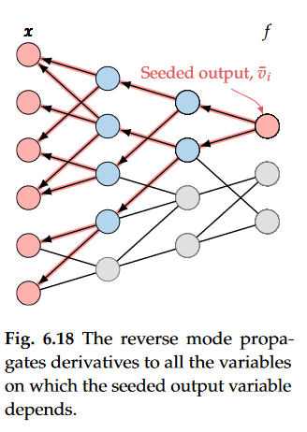
Laplace approximation is an optimization-based approach. Hence, we want to speed up and make differentials as precise as possible. Here reverse mode AD is great because it runs in O(1) for multiple input and in O(n) for multiple outputs. Because we have a lot of inputs but very few outputs it is a great tool for us.
TMB is an AD library for C++

